Slide 1
The Business Game
Squeeze the Juice

Slide 2



MOBA/Battle Royale for Simulation Genera
Player vs. player
Matches upto 1 hour
Skill based
Real-time

Slide 3
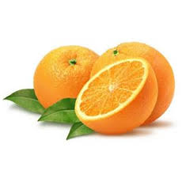
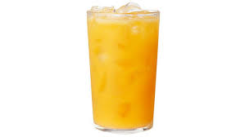




Business Model
Each player will have one business and each business will convert one input (X) into one output (Y)
$$X$$
$$\frac{∆Y}{∆t} = \frac{∆X}{∆t}E$$
$$Y$$
$$E ∈ [0 1]$$
Efficency is deteremined by a skill based challenge.

Slide 4
Efficency

Slide 5

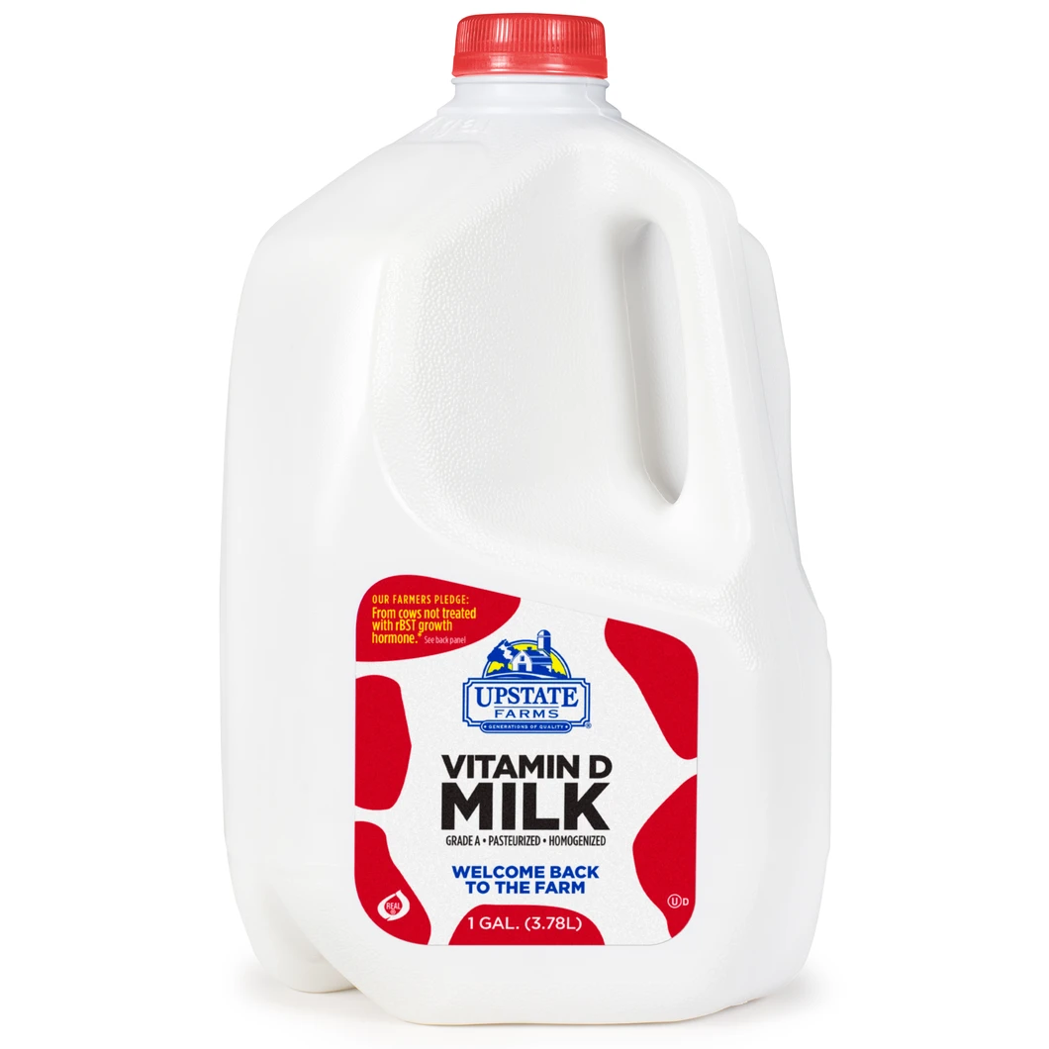
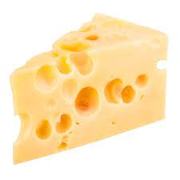
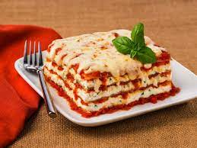
Economy
Source
Competeting Businesses
Market
Competeting Businesses
Market
Sink

Slide 6
Source and Sink

Slide 7
Market

Slide 8
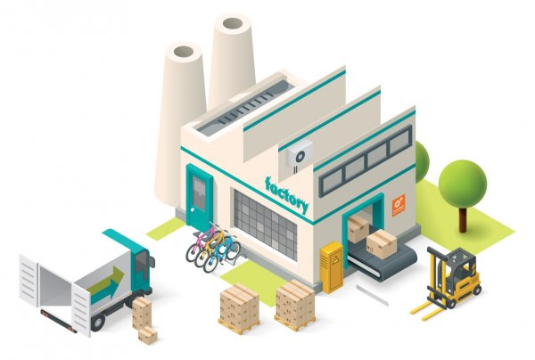
Main Interface
Company 3 is selling grass at $2.50 ea.
Balance: $1000 Efficency: 0.6 Grass: 234 Milk: 862
Company 5 is selling Milk at $2.50 ea.
Company 1
Compnay 2
Company 3
...
Company 4
Compnay 5
Company 6
...
Company 2: Woudl you like to buy some grass? 1000 @ $2 ea.
SKILL GAME
Company 2: Woudl you like to buy some grass? 1000 @ $2 ea.
Send
Send

Slide 9
Ads

